Slide 1
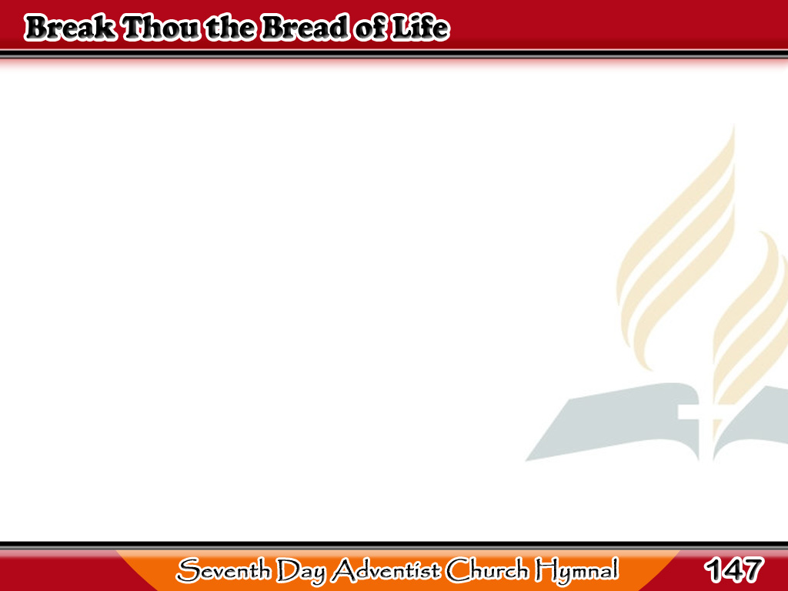
Tinapay ng Buhay ay Hatiin
Break Thou the bread of life,
Dear Lord, to me,
As Thou didst break the loaves
Beside the sea;
1/4

Slide 2
Tinapay ng Buhay ay Hatiin
Beyond the sacred page
I seek Thee, Lord;
My spirit pants for Thee,
O living Word.
1/4

Slide 3
Tinapay ng Buhay ay Hatiin
Bless Thou the truth, dear Lord,
To me, to me,
As Thou didst bless the bread
By Galilee;
2/4

Slide 4
Tinapay ng Buhay ay Hatiin
Then shall all bondage cease,
All fetters fall;
And I shall find my peace,
My all in all.
2/4

Slide 5
Tinapay ng Buhay ay Hatiin
Thou art the bread of life,
O Lord, to me;
Thy holy Word the truth
That saveth me;
3/4

Slide 6
Tinapay ng Buhay ay Hatiin
Give me to eat and live
With Thee above;
Teach me to love Thy truth,
For Thou art love.
3/4

Slide 7
Tinapay ng Buhay ay Hatiin
Spirit and life are they,
Words Thou dost speak;
I hasten to obey,
But I am weak;
4/4

Slide 8
Tinapay ng Buhay ay Hatiin
Thou art my only help,
Thou art my life;
Heeding Thy holy
Word I win the strife.
4/4

